Slide 2
WHY WE DO THIS
Encourage youth to be involved in the church
Bring non-orthodox youth into the church
Bringing the ROCOR community together
Cultural preservation
Raise money for the Youth Organizations
Connecting the youth and the clergy

Slide 3
Target Audience
16+
300
$200
Age
Number of Attendees
Ticket Price
INTERESTS
Marriage
Orthodoxy
Good time

Slide 4
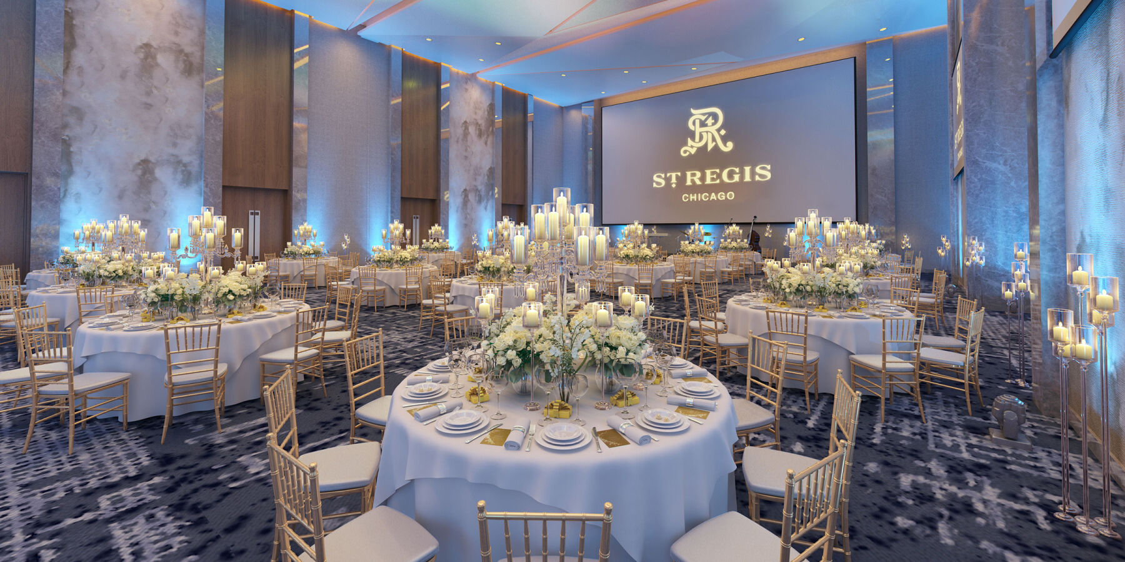
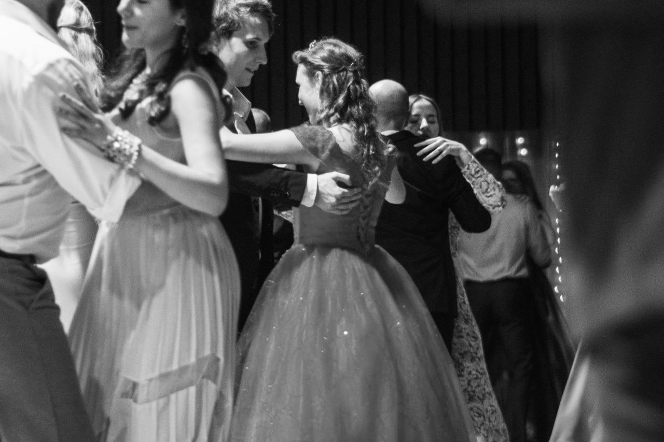
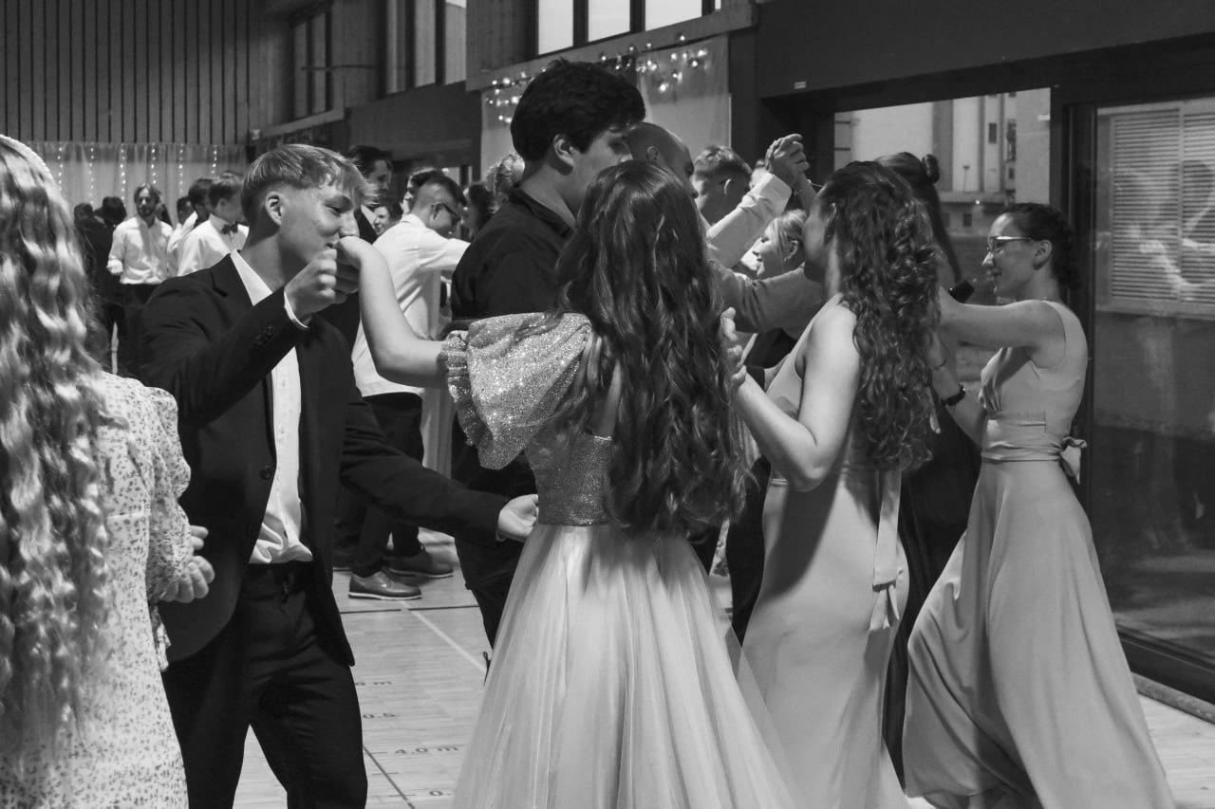
Ball Itinerary
DATE: 14.02.2025
NUMBER OF PARTICIPANTS: 300
PLACE:
The Russian Center
of San Francisco
International Day of Orthodox Youth (15.02.)
6:00 pm - Meeting at the Russian Center of San Francisco (2450 Sutter Street), Cocktail Hour
7:00 pm - Greeting from Clergy and Host, Moleben
7:45 pm - Dinner served & Bar is closed
8:30 pm - Traditional Performances
9:30 pm - Learning Traditional Dances (all welcome to join)
10:20 pm - Bar is reponed/ Open dance floor

Slide 5
Name | # Billed | Price | Sub Total | Gratuity | Tax Exempt | Total
Steak Skewer | 60 | 3.50 | 210.00 | 46.20 | - | 256.20
Caprese | 50 | 3.50 | 175.00 | 38.50 | - | 213.50
Grilled Sirloin | 170 | 26.00 | 4,420.00 | N/A | - | 4,420.00
Sauteed Salmon | 55 | 28.00 | 1,540.00 | 338.80 | - | 1,878.80
Mushroom Ravioli | 20 | 22.00 | 440.00 | 96.80 | - | 536.80
Ballroom Usage | 1 | 5,000.00 | 5,000.00 | - | - | 5,000.00
Open Bar Ticket | 150 | 25.00 | 3,750 | N/A | - | 3,750.00
Champagne Toast | 20 | 20.00 | 400.00 | 49.50 | - | 449.50
24x24 Dance Floor | 1 | 300.00 | 300.00 | - | - | 300.000
Guest Name/Meal & Table Cards | 1 | 150.000 | 150.00 | - | - | 150.000
Tickets | 300 | 200.00 | 12,635 | 569.8 | - | 60,000.00

Slide 6
Processing Fees
Participant Fee
200 dollars (187 €) per participant
Parking, Stay, and and Flight ticket not included
Payment options
- Crypto - Paypal - Cash - 8kgs goats
- Organic Free Range eggs
- Other livestock/ barter equalling fee
Total cost for ball: $15,000 - 18,000

Slide 7
THANKS!
Does anyone have any questions? nick-the-brick@fakemail.com +49 620 421 838

