Slide 1



Kulich
Group 8, ADOYC XIV 2024

Slide 2
KULTURE
UNITY
LANGUAGE
IDENTITY
CHURCH
HERITAGE

Slide 3


Goal
  Find a common denominator amongst local parishioners to overcome language barriers and other preexisting differences
    food/physical craft or skill is something everyone can participate in
  Accessible lesson plans/guides that outline each workshop
  Workshops
    Preserve traditional craft
    Engage parishioners
    Learn the importance & symbolism behind these traditions
    Motivate the next generation to participate in church life

Slide 4

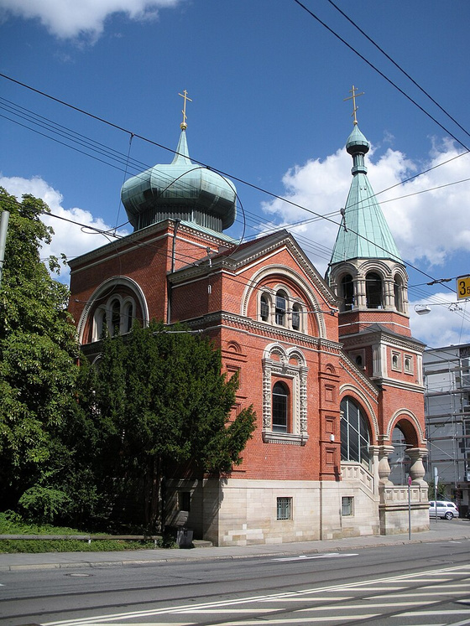
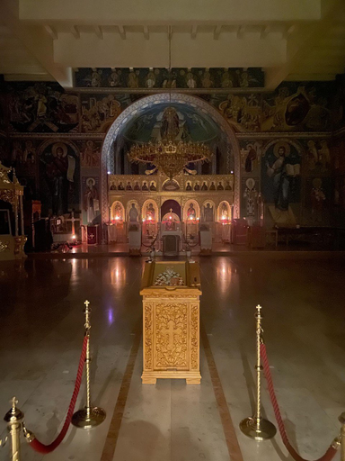
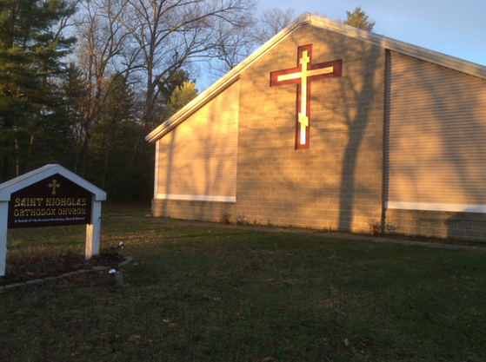
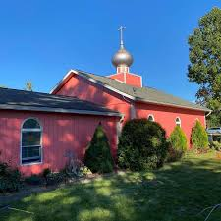
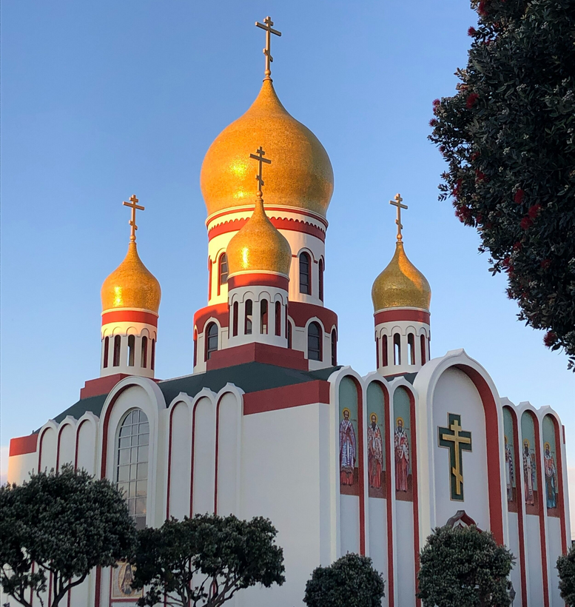
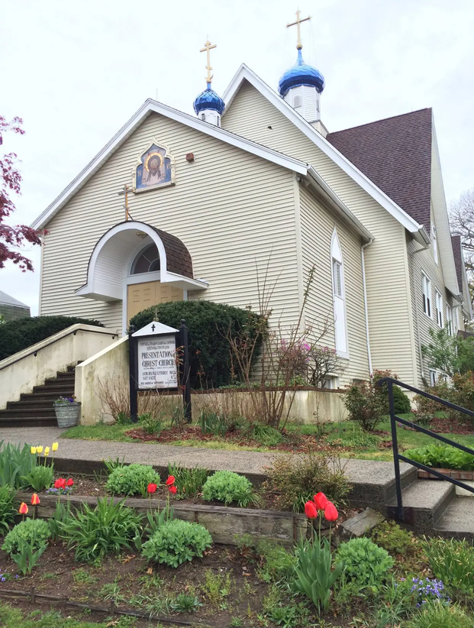
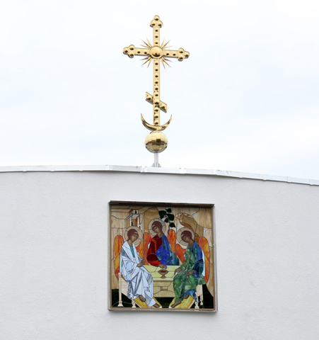

Slide 5
Date &
Duration
    4 times a year
    Sending step by step guides to parishes before every lent
    A day or two at each parish
(4 times a year)

Slide 6
Languages & Nutrition
  Russian
  English
  Local languages spoken in the area
  Light refreshments and appetizers
  Food made at the workshop
Being able to use our hands also to bond over cultural food so that language would not be a barrier

Slide 7
Participants
Parishioners of a ROCOR parish, about 10-20 people
Location
Within the local parish hall or paishioners house

Slide 8
Financing
The central organizers don’t incur any costs, so no fundraising is necessary (for the central organizers)
  Parishes face a free choice:
    Charge an admissions fee to cover the materials for the workshops
    Fund the workshops out of other money
  Central organizers will include cost estimates for workshop materials
    This helps parishes with the choice
    Our target is ≤ 20€ per participant

Slide 9
Materials
  At the central level no materials are necessary
  Central organizers will publish materials lists for each workshop

Slide 10
Technology
  Central organizers and local parish contacts must proficiently use computers
  Plans emailed to parishes
    Subscribe to a mailing list
    Also via social media: Facebook, Instagram
  Local organizers will need to:
    Check these emails
    Print materials

Slide 11



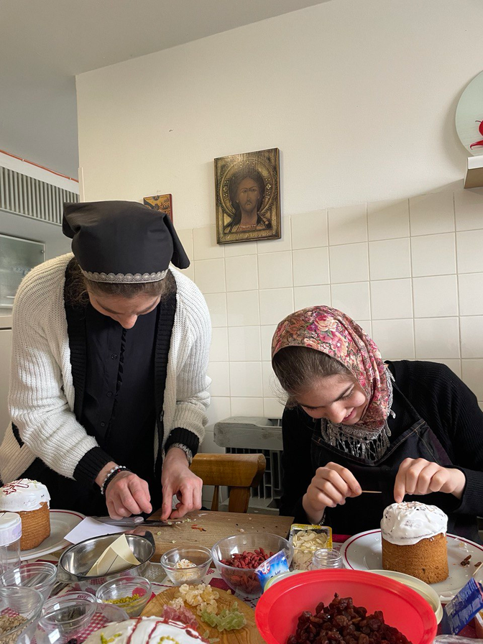
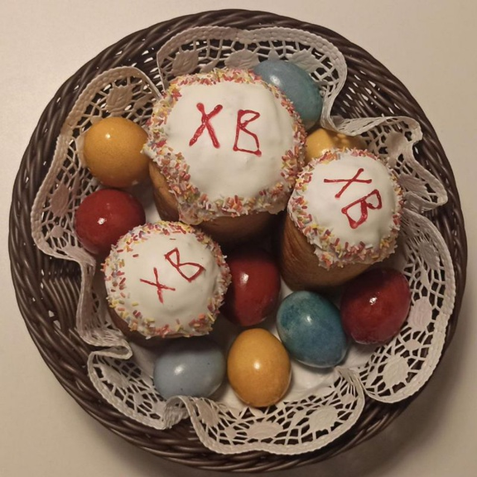
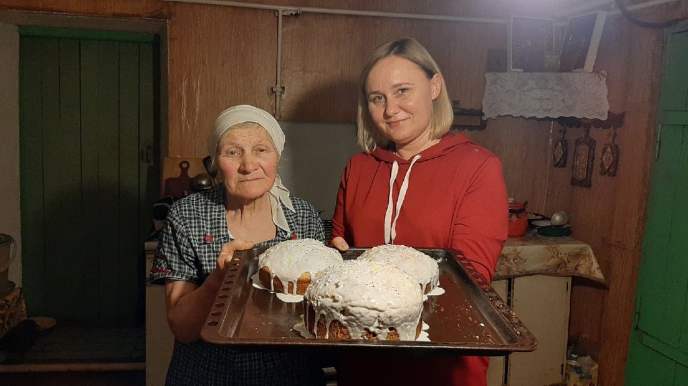

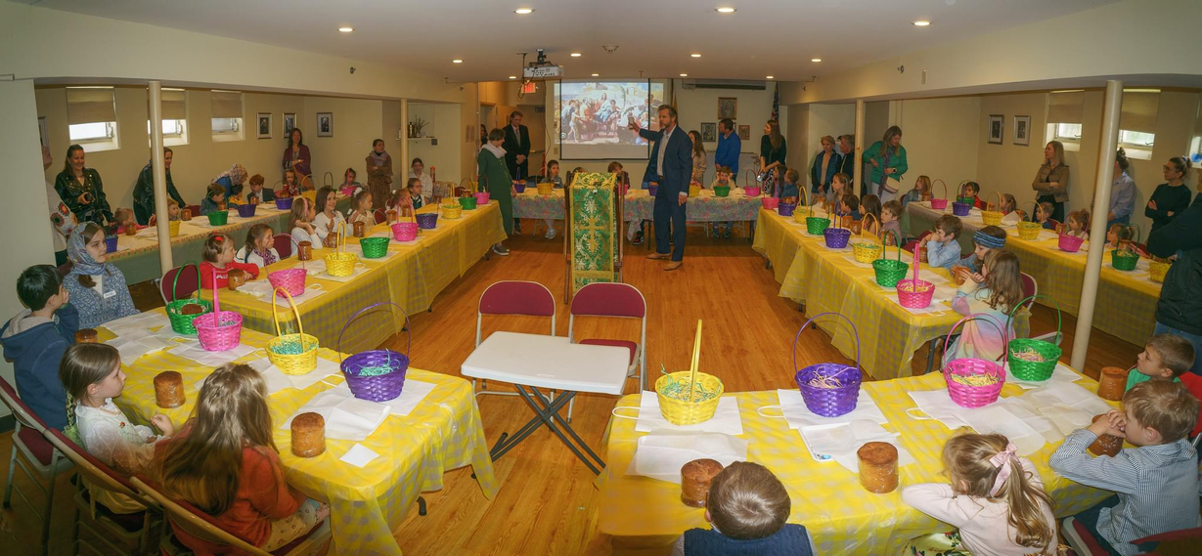

Slide 12

Instagram
  Posts each churches events — fosters a sense of community
  Other posts:
    Polls on which events and workshops community wants
    When new activities and workshops come out
    Announcements and post workshop get-togethers
    Share topic concepts

Slide 13
How do you plan to realize your project?
  Ask what the people are interested in via Instagram
  Plan the project a few months before
  Provide organizing support via newsletters
  Organizer of each parish gets the material
Monitoring group dynamics on site
  Feedback through pictures, posted on Instagram
  Maybe a short feedback - what did work great and what not
Realization

Slide 14
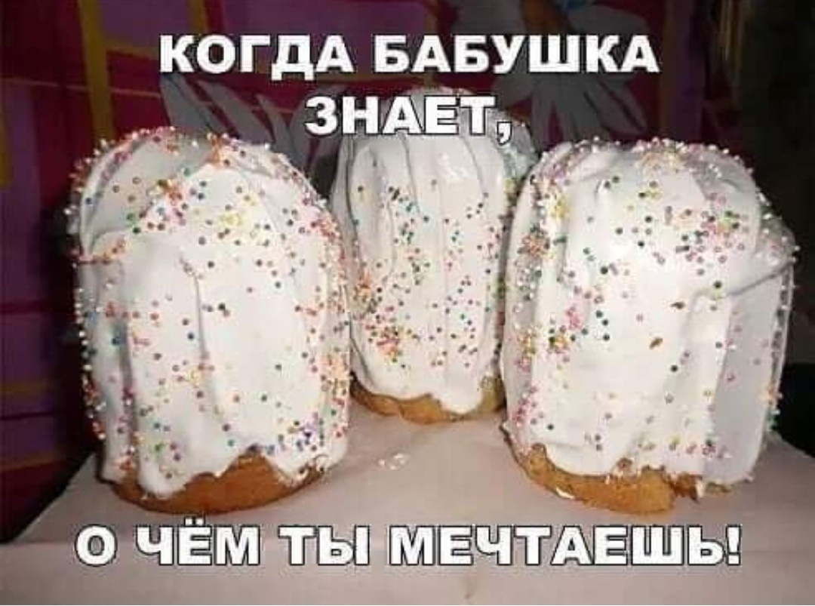

Slide 15

Thank you!

