Slide 1
OrthoFest
Preserving ROCOR Identity In Your Parish

Slide 2
Preserving ROCOR identity by uniting our global ROCOR community around community heritage and tradition
parish history
Mission Statement

Slide 3
Bringing together our global ROCOR…
Problem:
Majority of our ROCOR parishioners lack knowledge of our Church’s History
A common cause:
Uniting our ROCOR community through a major fundraising event for restoration & preservation of our historic buildings and holy sites
Implementation
Local OrthoFests in parishes combining cultural and educational elements
Planning:
Organization: Synod-level Execution: Diocese-level

Slide 4
Event Description
Join us for a one-day celebration of Orthodox Christian faith, culture, and cuisine!
delectable dishes
festive music
engaging conversations
unique shopping
Booths featuring Orthodox-owned crafts and religious items.

Slide 5
First OrthoFest will be held at…

Slide 6
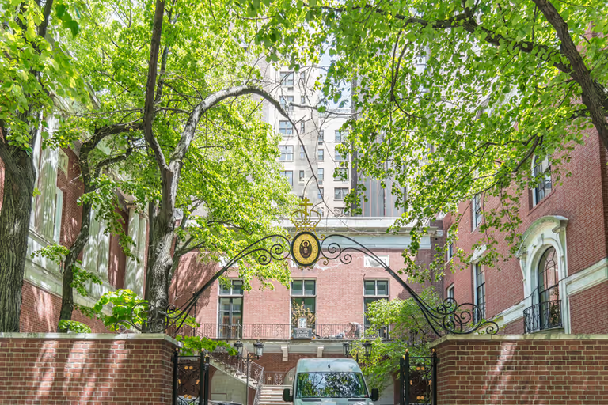
Synod of Bishops, NYC

Slide 7
Cultural Food Vendors
Arts Displays
Merchandise
Maxim Demitry
Hand-painted Icons and Lessons
Minsk Nuns
Live Music
HTM Bookstore
Nyack Bookstore
Clothing
Orthodox Depot
Samovar
Избушка
Vanka Stanka
Taste of Europe

Slide 8
How Will We Organize Events?
Planning
Advertise the event
Attaining our Budget
Setting up
Global coordination through Synod of Bishops
Metropolitans in charge of execution in individual countries
6 months in advance
Open an LLC that will open a line of credit for our company
The workforce of volunteers will gather the day off to organize and assemble the group.
Digital and physical advertisement to increase attendance
Reach out to businesses

Slide 10
Thank you!
Спасибо!
Danke!

